Slide 1
NETWORKING AND ROUTING PROTOCAL ET 8315
Wednesday, May 29, 2024
Mr. Cuthbert John Karawa
Lecture 6
Open Shortest Path First
College of Information and Communication Technology (CoICT)
Department Of Electronics And Telecommunications Engineering.
1
Notes:
1

Slide 2
Introduction
Open Shortest Path First (OSPF) is an open standards routing protocol that’s been implemented by a wide variety of network vendors, including Cisco.
If you have multiple routers and not all of them are Cisco, the only options you have are basically RIPv1, RIPv2, or OSPF.
If it’s a large network, then, really, your only option is OSPF.
It works by using the Dijkstra algorithm.

Slide 3
Open Shortest Path First(OSPF) Basics
First, a shortest path tree is constructed, and then the routing table is populated with the resulting best paths.
OSPF converges quickly, although perhaps not as quickly as EIGRP, and it supports multiple, equal-cost routes to the same destination.
But unlike EIGRP, it only supports IP routing.
Open Shortest Path First (OSPF) is a link-state routing protocol that was developed for IP networks and is based on the Shortest Path First (SPF) algorithm.

Slide 4
Open Shortest Path First(OSPF) Basics
OSPF provides the following features:
Consists of areas and autonomous systems
Minimizes routing update traffic
Allows scalability
Supports VLSM/CIDR
Has unlimited hop count.
Allows multi-vendor deployment (open standard)

Slide 5
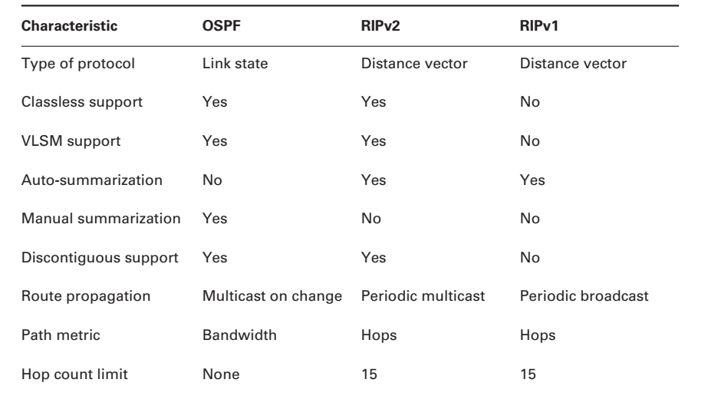
Comparison between OSPF, RIPv2 and RIPv1

Slide 6
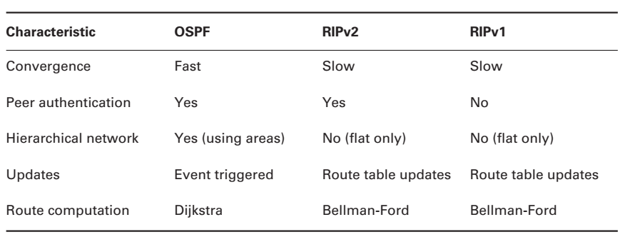
Comparison between OSPF, RIPv2 and RIPv1

Slide 7
Open Shortest Path First(OSPF) Basics
OSPF is supposed to be designed in a hierarchical fashion, which basically means that you can separate the larger internetwork into smaller internetworks called areas. This is the best design for OSPF.
The reasons for creating OSPF in a hierarchical design include:
To decrease routing overhead
To speed up convergence
To confine network instability to single areas of the network

Slide 8
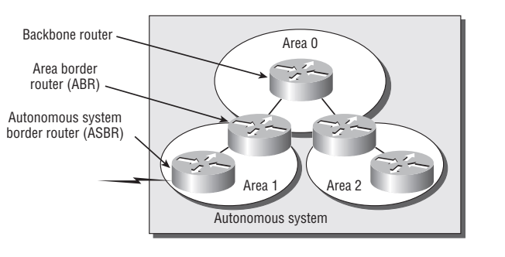
Open Shortest Path First(OSPF) Basics
This does not make configuring OSPF easier, but more elaborate and difficult. Figure below shows a typical OSPF simple design.

Slide 9
Open Shortest Path First(OSPF) Basics
You can notice how each router connects to the backbone, called area 0, or the backbone area.
OSPF must have an area 0, and all routers should connect to this area, but routers that connect other areas to the backbone within an AS are called Area Border Routers (ABRs). Still, at least one interface must be in area 0.
OSPF runs inside an autonomous system, but can also connect multiple autonomous systems together.

Slide 10
Open Shortest Path First(OSPF) Basics
The router that connects these ASes together is called an Autonomous System Boundary Router (ASBR).

Slide 11
OSPF Terminologies
Link ,A link is a network or router interface assigned to any given network. When an interface is added to the OSPF process, it’s considered by OSPF to be a link. This link, or interface, will have state information associated with it (up or down) as well as one or more IP addresses.
Router ID, this is an IP address used to identify the router. If no loopback interfaces are configured with addresses, OSPF will choose the highest IP address of all active physical interfaces.

Slide 12
OSPF Terminologies
Link ,A link is a network or router interface assigned to any given network. When an interface is added to the OSPF process, it’s considered by OSPF to be a link. This link, or interface, will have state information associated with it (up or down) as well as one or more IP addresses.
Router ID, this is an IP address used to identify the router. If no loopback interfaces are configured with addresses, OSPF will choose the highest IP address of all active physical interfaces.

Slide 13
OSPF Terminologies
Neighbors; this are two or more routers that have an interface on a common network, such as two routers connected on a point-to-point serial link.
Adjacency is a relationship between two OSPF routers that permits the direct exchange of route updates. OSPF is really selective about sharing routing information, unlike EIGRP,which directly shares routes with all of its neighbors.
Notes:
Adjacency Instead, OSPF directly shares routes only with neighbors
that have also established adjacencies. And not all
neighbors will become Adjacent, this depends upon both the
type of network and the configuration of the routers.

Slide 14
OSPF Terminologies
Hello protocol provides dynamic neighbor discovery and maintains neighbor relationships. Hello packets and Link State Advertisements (LSAs) build and maintain the topological database. Hello packets are addressed to 224.0.0.5.
Neighborship database is a list of all OSPF routers for which Hello packets have been seen. A variety of details, including the Router ID and state, are maintained on each router in the neighborship database.

Slide 15
OSPF Terminologies
Topology database contains information from all of the Link State Advertisement packets that have been received for an area. The router uses the information from the topology database as input into the Dijkstra algorithm that computes the shortest path to every network.
Link State Advertisement (LSA) is an OSPF data packet containing link-state and routing information that’s shared among OSPF routers. There are different types of LSA packets. An OSPF router will exchange LSA packets only with routers to which it has established adjacencies.

Slide 16
OSPF Terminologies
Designated router (DR) is elected whenever OSPF routers are connected to the same multi-access network.
Backup designated router (BDR) is a host standby for the DR on multi-access links (remember that Cisco sometimes likes to call these “broadcast” networks). The BDR receives all routing updates from OSPF adjacent routers, but doesn’t flood LSA updates.
OSPF areas is a grouping of contiguous networks and routers. All routers in the same area share a common Area ID.
Notes:
DR- Cisco likes to call these “broadcast” networks, but really, they are networks that have multiple recipients. Try not to confuse multi-access with multipoint, which can be easy to do sometimes. A DR is chosen (elected) to disseminate/receive routing information to/from the remaining routers on the broadcast network or link. This ensures that their topology tables are synchronized. All routers on the shared network will establish adjacencies with the DR and Backup Designated Router (BDR).
OSPF AREAS- Because a router can be a member of more than one area at a time, the Area ID is associated with specific interfaces on the router. This would allow some interfaces to belong to area 1 while the remaining interfaces can belong to area 0. All of the routers within the same area have the same topology table. When configuring OSPF, you’ve got to remember that there must be an area 0, and that this is typically configured on the routers that connect to the backbone of the network. Areas also play a role in establishing a hierarchical network organization, something that really enhances the scalability of OSPF

Slide 17
OSPF Terminologies
Broadcast (multi-access) networks such as Ethernet allow multiple devices to connect to (or access) the same network, as well as provide a broadcast ability in which a single packet is delivered to all nodes on the network. In OSPF, a DR and a BDR must be elected for each broadcast multi-access network.
Non-broadcast multi-access (NBMA) networks are types such as Frame Relay, X.25, and Asynchronous Transfer Mode (ATM). These networks allow for multi-access, but have no broadcast ability like Ethernet. So, NBMA networks require special OSPF configuration to function properly and neighbor relationships must be defined

Slide 18
SPF Tree Calculation
Within an area, each router calculates the best/shortest path to every network in that same area. This calculation is based upon the information collected in the topology database and an algorithm called shortest path first (SPF).
Picture each router in an area constructing a tree. This is the shortest path tree used by the router to insert routes into the routing table.

Slide 19
SPF Tree Calculation
Note that this tree contains only networks that exist in the same area as the router itself does. If a router has interfaces in multiple areas, then separate trees will be constructed for each area.
One of the key criteria considered during the route selection process of the SPF algorithm is the metric or cost of each potential path to a network. But this SPF calculation doesn’t apply to routes from other areas.

Slide 20
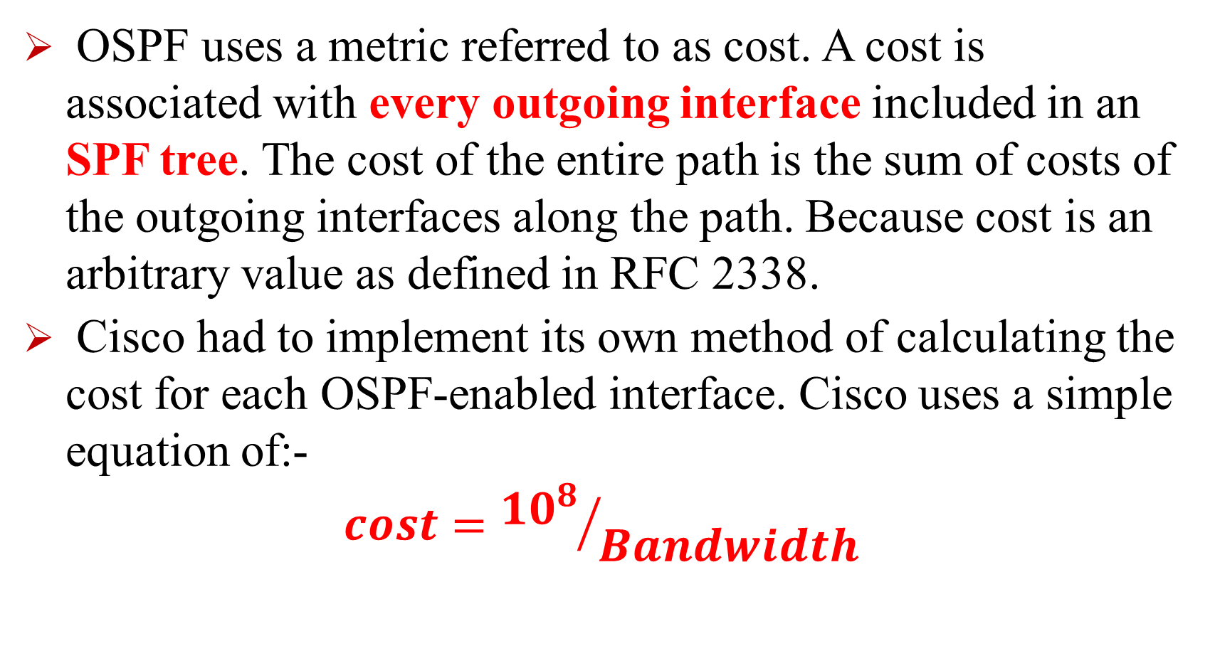
SPF Tree Calculation
OSPF uses a metric referred to as cost. A cost is associated with every outgoing interface included in an SPF tree. The cost of the entire path is the sum of costs of the outgoing interfaces along the path. Because cost is an arbitrary value as defined in RFC 2338.
Cisco had to implement its own method of calculating the cost for each OSPF-enabled interface. Cisco uses a simple equation of:-
$$cost={{10}^{8}}/{Bandwidth}$$

Slide 21
SPF Tree Calculation
The bandwidth is the configured bandwidth for the interface. Using this rule, a 100Mbps Fast Ethernet interface would have a default OSPF cost of 1 and a 10Mbps Ethernet interface would have a cost of 10.
This value may be overridden by using the ip ospf cost command. The cost is manipulated by changing the value to a number within the range of 1 to 65,535. Because the cost is assigned to each link, the value must be changed on the same interface that you want to change the cost on.

Slide 22
Configuring OSPF
Configuring basic OSPF isn’t as simple as RIP, IGRP, and EIGRP, and it can get really complex once the many options that are allowed within OSPF are factored in.
There two basic elements of OSPF configuration
Enabling OSPF
Configuring OSPF areas

Slide 23
Configuring OSPF
Enabling OSPF
The command you use to activate the OSPF routing process is:
Lab_A(config)#router ospf ?
<1-65535>
A value in the range 1–65,535 identifies the OSPF Process ID. Different OSPF routers don’t have to use the same Process ID in order to communicate. It’s purely a local value that essentially has little meaning, but it cannot start at 0, it has to start at a minimum of 1.

Slide 24
Configuring OSPF
Configuring OSPF Areas
After identifying the OSPF process, you need to identify the interfaces that you want to activate OSPF communications on, as well as the area in which each resides. This will also configure the networks you’re going to advertise to others. OSPF uses wildcards in the configuration; Here’s an OSPF basic configuration example;

Slide 25
Configuring OSPF
Configuring OSPF Areas
Here’s an OSPF basic configuration example;
Lab_A#config t
Lab_A(config)#router ospf 1
Lab_A(config-router)#network 10.0.0.0 0.255.255.255 area ?
<0-4294967295> OSPF area ID as a decimal value
A.B.C.D OSPF area ID in IP address format
Lab_A(config-router)#network 10.0.0.0 0.255.255.255 area 0

Slide 26
Configuring OSPF
The arguments of the network command are the network number (10.0.0.0) and the wildcard mask (0.255.255.255).
The combination of these two numbers identifies the interfaces that OSPF will operate on, and will also be included in its OSPF LSA advertisements.
OSPF will use this command to find any interface on the router configured in the 10.0.0.0 network, and it will place any interface it finds into area 0. Notice that you can create about 4.2 billion areas.

Slide 27
Configuring OSPF
A quick review of wildcards: A 0 octet in the wildcard mask indicates that the corresponding octet in the network must match exactly. On the other hand, a 255 indicates that you don’t care what the corresponding octet is in the network number. A network and wildcard mask combination of 1.1.1.1 0.0.0.0 would match 1.1.1.1 only, and nothing else. This is really useful if you want to activate OSPF on a specific interface in a very clear and simple way.
If you insist on matching a range of networks, the network and wildcard mask combination of 1.1.0.0 0.0.255.255 would match anything in the range 1.1.0.0–1.1.255.255

Slide 28
Configuring OSPF
The final argument is the area number.
It indicates the area to which the interfaces identified in the network and wildcard mask portion belong. Remember that OSPF routers will only become neighbors if their interfaces share a network that’s configured to belong to the same area number.
The format of the area number is either a decimal value from the range 1–4,294,967,295 or a value represented in standard dotted-decimal notation. For example, area 0.0.0.0 is a legitimate area, and is identical to area 0.

Slide 29
Home Work
EIGRP
ISIS

Slide 30

30
Notes:
30

Slide 31
THANK YOU
Notes:
31

